Slide 1
CLIC 804:
Innovation by
Design
Session 09:
System-level Innovation Pyramid Assessment
Dr. Tim Faley
University of the Virgin Islands
Tfaley@UVI.edu

Slide 2
The Innovation Pyramid
The Situation
Impact

Slide 3
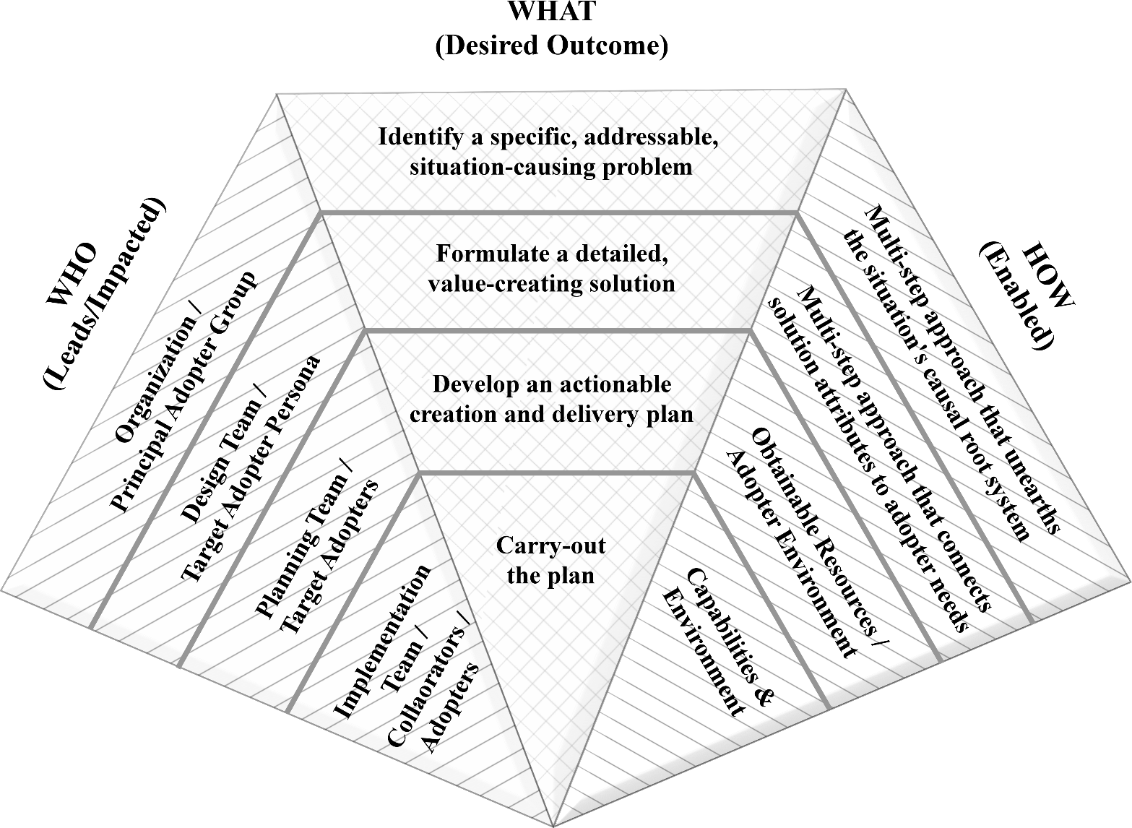
Pyramid Flow
Level 1: Design Stage 1
Level 2: Design Stage 2
Level 3: Execution Stage 1
Level 4: Execution Stage 2

Slide 4
We won’t know until we get there
Throughout The Innovation Pyramid methodology we are making choices.
Micro-level decisions
“Best” choices we could make, given what we knew at the time. Choices were based on clear Criteria.
Those choices put us on a path forward, and diverted us away from other paths
Once the innovation is in the hands of adopters, we know much, much more…
How did the results (macro-level) compare to our originally desired-outcome?

Slide 5
We won’t know until we get there
Situation
Progression Through The Pyramid
Overall Potential Outcomes
Outcome
We Obtained
Outcome We
Originally Desired

Slide 6
Micro versus Macro Assessment
There is assessment built into each Level of the Pyramid
Micro-level assessments
Ensures that “rational and reasonable” decisions are made
Criteria based on our understanding at the time
Post-project review
Macro-level assessment; how well did we do versus the overall impact (macro desired-outcome) we had hoped to make?

Slide 7
Systematically Review our choices
We have created a new BATNO for our adopters
Why did it work for them? What are the adopter’s perceived limitations of the new innovation?
More research. More Interviews for Insight.

Slide 8
System-level Assessment Flowchart
Copyright © 2019 by Timothy L Faley

Slide 9
Don’t blame…. learn
The implementors of the plan
We can only judge whether they “did things right”
Whether the “right things were done” was the result of prior choices
The project’s “limited” resources
Another common scapegoat to “failure”
Usually not the issue
There is no “failure” only learning
What do we now know that we did not?

Slide 10
Example: more details in Chapter 7
Student attrition
Poor student grades
Lack of understanding of course material
SOLUTION: Increase Tutoring options
Result: No Change in attrition? What happened?
Further research reveals:
Students paying their own way
Working full-time (for pay) while taking a full load of classes
“Lack of time” is their root issue
Unless we address THAT issue, the impact will not be achieved!

Slide 11
Learning is critical to serial innovators
If we (or our organization) desire to be serial innovators
Must learn from EACH use of the Pyramid method
Prototypes and Pilot programs are but the FIRST time through the Pyramid.
Final innovation must be created via a SECOND time through the Pyramid

Slide 12
Questions?
See syllabus for time/date of next zoom session.

