Slide 1
CLIC 804:
Innovation by
Design
Session 07C:
Persona Development
Dr. Tim Faley
Kiril Sokoloff Distinguished Professor of Entrepreneurship
Special Assistant to the President for Entrepreneurial Initiatives
University of the Virgin Islands
St. Thomas Campus; Tfaley@UVI.edu

Slide 2
Personas
Persona
A archetype adopter
Based on decision-driving needs/wants/desires
Someone who has a specific want/need/desire that is affected by a technology effect

Slide 3
Persona Development
Is an ORGANIZE step
Take all the information generated by the Interviews for Insight (Diverge step) and other primary and secondary research and aggregate it into Personas
This is a TWO-step process
Categorize the IFI data
Connect various categories to specific Personas

Slide 4
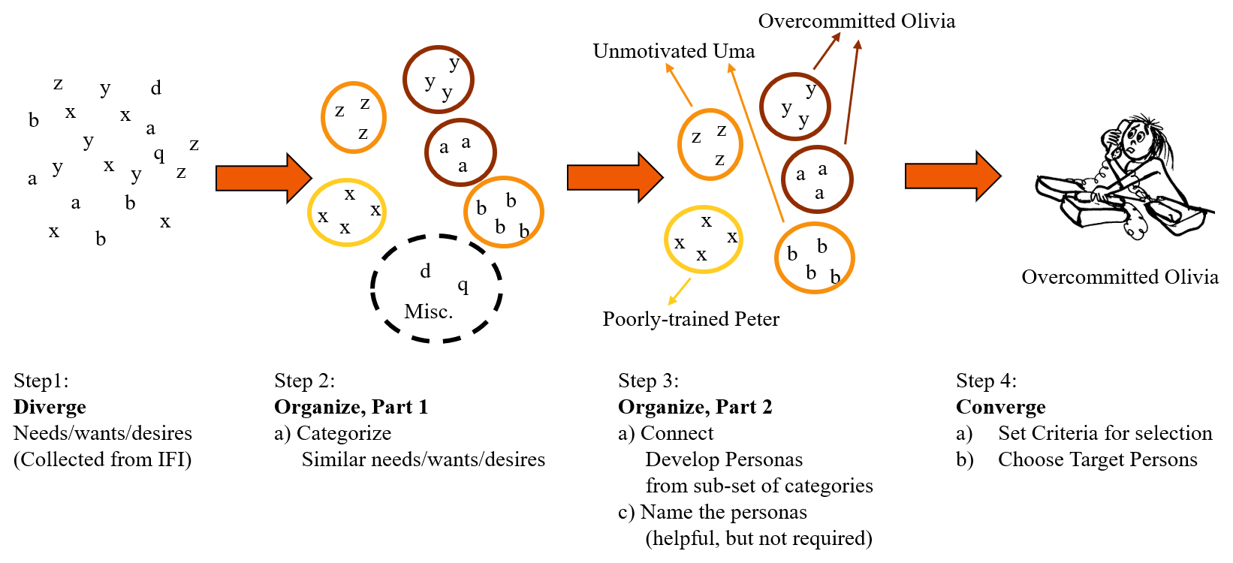
IFI to Target Persona

Slide 5
Objectives of Persona Modeling
Identify those who think and choose alike
Gather insight into behavioral dynamics
Needs and desires
Thought modes
Behavior in different situations

Slide 6
Persona Attributes
Build a picture of…
Valued effects
Different personas have different values
Decision States
Persona’s have a decision process

Slide 7
AnnTaylor Stores Corp. example
Read “What would Ann Do?” on Blackboard in “Readings” folder
“Ann”
“Loft”
Which Way?
(if either)
Elegant
Budget Impact
Hip
Casual
Professional

Slide 8
Adopter ←→ Innovation
Illustrates the connections
What value proposition does your innovation create for the would-be adopter?
What is the offering attribute that creates this effect?

Slide 9
Creating a Persona
Propose persona categories
Wants – Objectives categories – best for uncovering value
Aggregate on common decision-driving needs/wants/desires
Construct a story (storyboard the process)
Describe the person
Describe the wants, objectives, motivations
Identify examples
Specific people
Experience-based constructs
Interviews

Slide 10
Persona Examples: Auto Shoppers
Needs? Desired Effects?
Budget Impact?
Image?
Other?
“Soccer-mom Mary”
“Player Paul”

Slide 11
Summary
Persona development is a powerful ORGANIZE tool
Produces an arch-type adopter who thinks and chooses alike
Allows you to better “see” how they will use and be impacted by your innovation

Slide 12
Questions?
See syllabus for time/date of Zoom session.

