Slide 1
CLIC 804:
Innovation by
Design
Session 07A:
Innovation Pyramid Level 2– Solution Formulation
Dr. Tim Faley
Kiril Sokoloff Distinguished Professor of Entrepreneurship
Special Assistant to the President for Entrepreneurial Initiatives
University of the Virgin Islands
Tfaley@UVI.edu

Slide 2
Pyramid Level 2, Design Stage 2
Solution Formulation

Slide 3
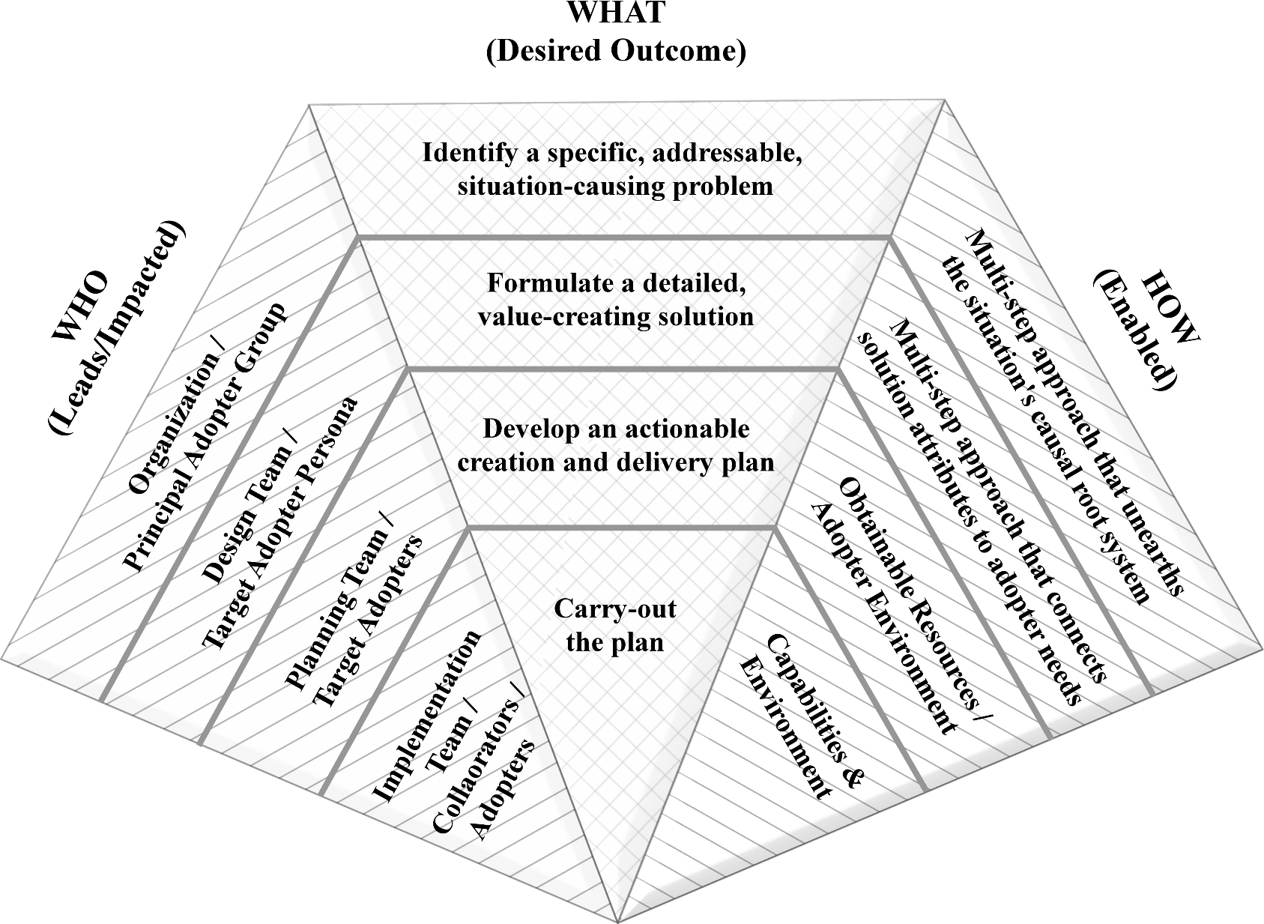
Level 2: Design, Stage II (Solution Formulation)

Slide 4
Starting Point is endpoint of Level 1
At the End of Level 1:
Defined a General Problem from our initial situation.
Determined a root cause of that General Problem for which our organization is able and willing to resolve.
Understood the connections between the root cause and the General Problem.
Identified an adopter group, the Principal Adopters, that is both impacted by the root cause issue and is the broad group for whom we are creating the innovation.

Slide 5
End point of Level 2
Specific new solution (detailed and fully-designed).
Specific Target Adopter persona (narrowed from the “Principal Adopter” group) with clearly identified unmet or under-met needs, wants and/or desires.
Distinct value proposition: clear connection between the features of the new solution with the need/wants/desires of the Target Adopter persona.

Slide 6
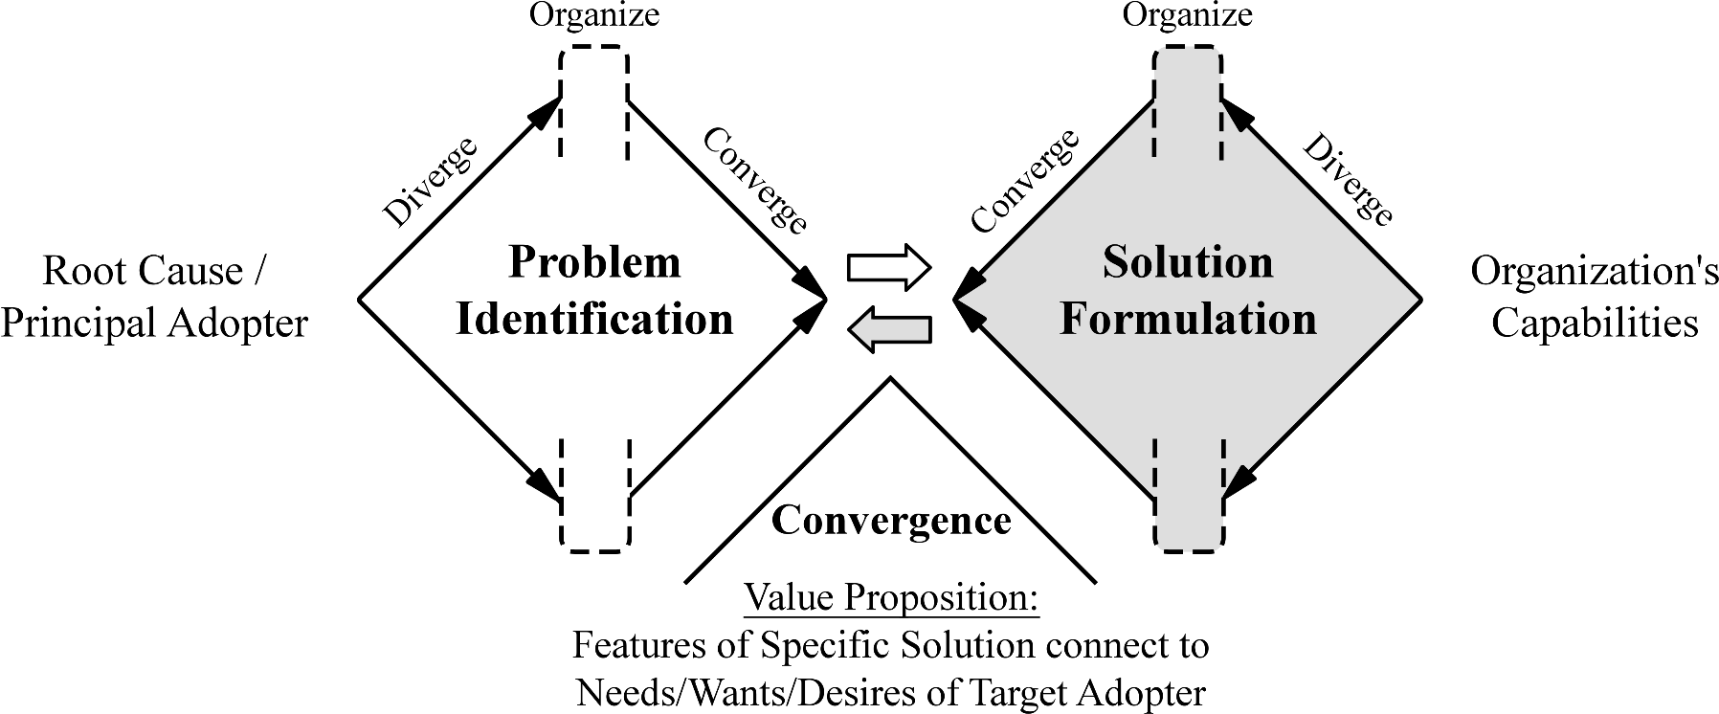
Design Stages 1 and 2 are Iterative
Convergence of Problem Identification and Solution Formulation
Will likely iterate back-and-forth between these two stages to reach convergence

Slide 7
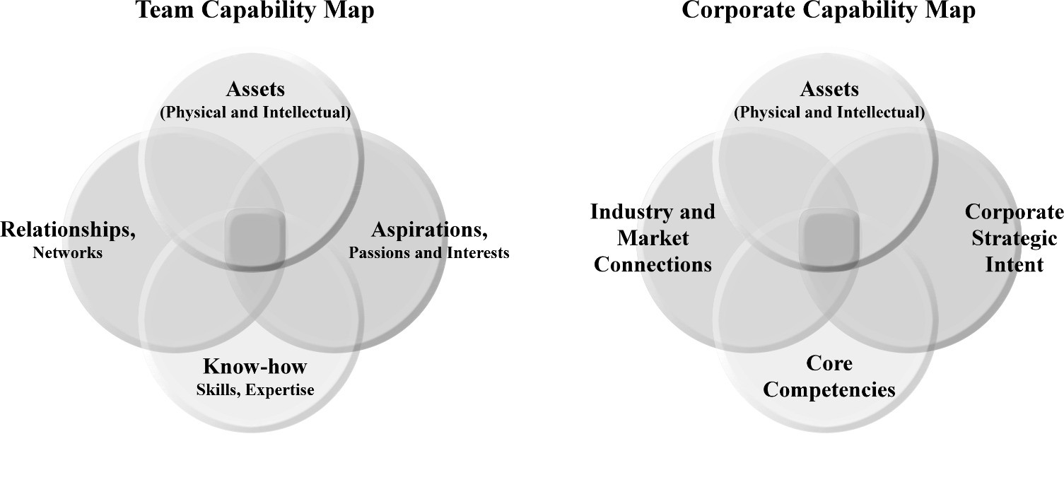
Organization’s Capabilities
“Willing and Able”
Organization’s starting point for a solution is that it is “willing and able” to address the identified issue
“Willing” means that the problem falls into the scope of the organization’s charter/vision (or Goals)
“Able” means that the organization has the capabilities to address the problem

Slide 8
Pyramid Level 2 method overview
Step 1: Describe a specific Target Adopter persona.
Identify Principal Adopter’s current BATNO (Best Alternative To a New Option).
Perform open-ended interviews to obtain insight.
Craft personas from the unmet or under-met needs, wants and/or desires uncovered during the interviews.
Select a Target Adopter persona.
Step 2: Determine a solution approach.
What are the solution’s “guiding principles”?
Step 3: Craft a detailed solution.
Step 4: Establish a clear value proposition.
Step 5: Quantify the Target Adopter group size.
Often defer this step until needed in Level 3 (Execution Planning)

Slide 9
Step 1. Narrow from Principal to Targer Adopter
Step 1: Describe a specific Target Adopter persona.
Identify Principal Adopter’s current BATNO (Best Alternative To a New Option).
Perform open-ended interviews to obtain insight.
Use Interviewing for Insight technique (Appendix A and next slide)
Craft personas from the unmet or under-met needs, wants and/or desires uncovered during the interviews.
Select a Target Adopter persona.

Slide 10
Interviewing for Insight (see deck 7B for details)
Who
360º around Principal Adopter
Start with Principal Adopter’s & BATNO
Best Alternative To a New Option for the Adopter
What do they like about it? What is not working for them?
Broaden interviews to include (perhaps)
Principal Adopter’s bosses, suppliers, industry experts, etc.
How
Let them talk. You are not selling your idea, you are gathering information (obtaining insights)
Pay attention to non-verbal ques (face-to-face conversation is best!)
What (Outcome)
Target Adopter has a clear set of unmet/under-met needs/wants desires

Slide 11
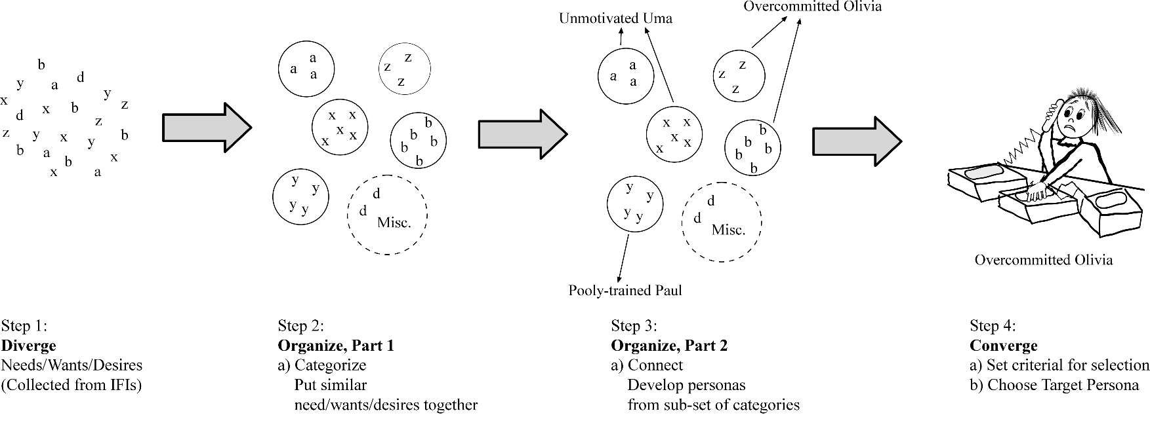
Using DOC Process to Analyze IFI data
See Slide Deck 7B and 7C for details on open-ended interviewing and Persona Development

Slide 12
Target Adopter development
For Details of Persona Development, see slide deck 07C.
For Details of open-ended interviewing (“Interviewing for Insight”), see slide deck 07B.

Slide 13
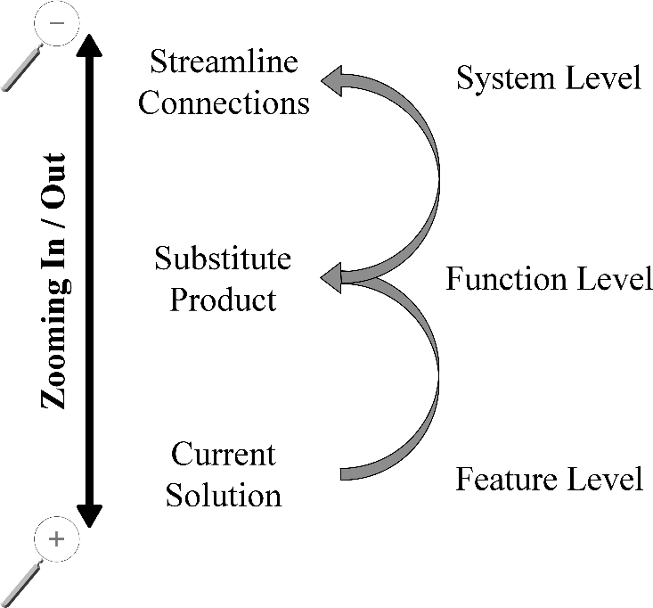
Level 2: Steps 2 and 3
Step 2: Determine a solution approach.
Get out of your pre-conceived “solution” box!
A “restaurant” is an approach; an “on-line degree-program” is an approach (neither are detailed solutions
Articulate “guiding principles” of the solution
Step 3: Craft a detailed solution.
Steps 3 & 4 will take NUMEROUS DOC Process Applications
Ensure work many levels

Slide 14
Generic Solution Approaches
Feature Level: “Me Too” Products--essentially a product/service to those that exist, but with some advantage, such as:
New Features. Increased convenience (ex. new delivery mechanism to user, Netflix vs. Blockbuster)
Inherent cost advantages over incumbents, such as:
Lower capital requirements
Lower raw material costs
Economy of scale (ex. Using the internet to get economy of scale for services)
Function Level: Substitute product (different solution for same need)
Better, faster, cheaper, more convenient than existing product/service
(ex: MP3 players vs. CD players)
Better addresses an emerging or previously unidentified or underserved market segment than existing offerings (ex: cell phones vs. land-lines)
Change forms: “Product as a service” or “Service as a product” (Pandora vs iTunes)
System Level: Streamline connections – creating efficiencies between existing business segments
Ebay bringing buyers and sellers together, reducing the cost of customer acquisition for sellers, and increasing convenience for buyers
Most apps are this: Uber and Lyft apps makes it easier for a taxi seeker to find taxi service
Analogies to other problem/solution pairs?
Eg: Mainframe to PC to Network → Central Power Creation to “off grid” to micro-grids
14

Slide 15
Level 2: Steps 4 and 5
Step 4: Establish a clear value proposition.
Step 5: Quantify the Target Adopter group size
Definitely QUALIFY them here (is there enough of them to make this worthwile?)
The QUANTification of the size can wait until we get to LEVEL 3 (Execution: Plan Development)
How to they connect?

Slide 16
Level 2: Design Stage 2 (Solution Formulation)

Slide 17
At the End of Level 2
Specific new innovation (detailed and fully-designed)
Specific target persona with clearly identified unmet or under-met needs, wants and/or desires
Value proposition: clear connection between the features of the new offering with the need/wants/desires of the Target Adopter persona
This is the assessment for Pyramid Levels 1 & 2

Slide 18
Examples
See Chapter 4 of text for examples on Solution Formulation

Slide 19
Common Mistakes
Problem Identification
Do not drill deep enough
Stop at top-level factor or cause
Stay with general “Principal Adopter” group description
Do not transform “root cause” into Need/Wants/Desires
Do not create a “Target Adopter” persona
Solution Formulation
Fail to account for current BATNO
Never consider what its short-comings are from POV of Principal Adopter
Fail to consider solutions on all 3 solution levels
Feature
Function (substitute products)
System

Slide 20
Questions?
See syllabus for time/date of next Zoom session.

