Slide 1
CLIC 804
Fall 2022
Session 06:
The DOC Process
Dr. Tim Faley
Kiril Sokoloff Distinguished Professor of Entrepreneurship
Special Assistant to the President for Entrepreneurial Initiatives
University of the Virgin Islands
Fall 2022

Slide 2
Diverge-Organize-Converge: The DOC Process

Slide 3
Overview of the DOC Process
Divergent Thinking Organize Convergent Thinking
Prioritize
Broaden
Possibilities
___________
___________
___________
_________
Choose
The “Best”
Or
“Most Impactful”
Divergent Thinking Steps
Convergent Thinking Steps
Divergent Thinking:
GO Fast!
NO thinking!
NO judgement
NO bad ideas
Listen and build off each other
Goal is to produce MANY
ALSO: Information Gathering (no analysis – just collecting information)
Organize
Combine/Classify concepts
Create Connections between ideas
Uncover underlying Causes
Lots of discussion
This is ANALYSIS
Research often Required
Convergent Thinking
Determine Criteria
for ranking (what is your measure of “best”?
Discuss
Choose
This is the SELECTION Step

Slide 4
Used in BOTH PI and SF
Technique used in BOTH Problem Identification and Solution Formulation
You are much more familiar with it for ideating new solution ideas
We saw in Session 05 (Problem Identification, Level 1) that the “archeological dig” (and any research) diversifies our concepts (i.e. broadens the possibilities)
This IS divergent thinking, but it is definitely not ‘brainstorming’
We then need to ORGANIZE this information and
CONVERGE on a single choice

Slide 5
Divergent Thinking
Expand IDEAS
Divergent Thinking
(one idea)
(Many, Many Ideas)
Gathering information (detective work) and Ideating

Slide 6
Organize: Transition/Synthesis Step
Organize
Categorize: Combine/Classify concepts
Create Connections between ideas
Inside the categorizes and between them
Uncover underlying Causes if possible
Lots of discussion
Research (primary & secondary research) needed
This is the step where ANALYSIS takes place

Slide 7
Convergent Thinking
Narrow and select the “Best” or “Most Impactful”
Convergent Thinking
(Organized Concepts)
The “Best”
Or
“Most Impactful”
For Problem Identification
Which of the “root causes” has the most
impact on the overall General Concern
or Specific Issue?
For Solution Formulation
Is it addressing an underlying cause?
Is it connected to multiple causes?
Set Criteria for ranking
Discuss
Choose
7

Slide 8
DOC Process applied to Problem Identification

Slide 9
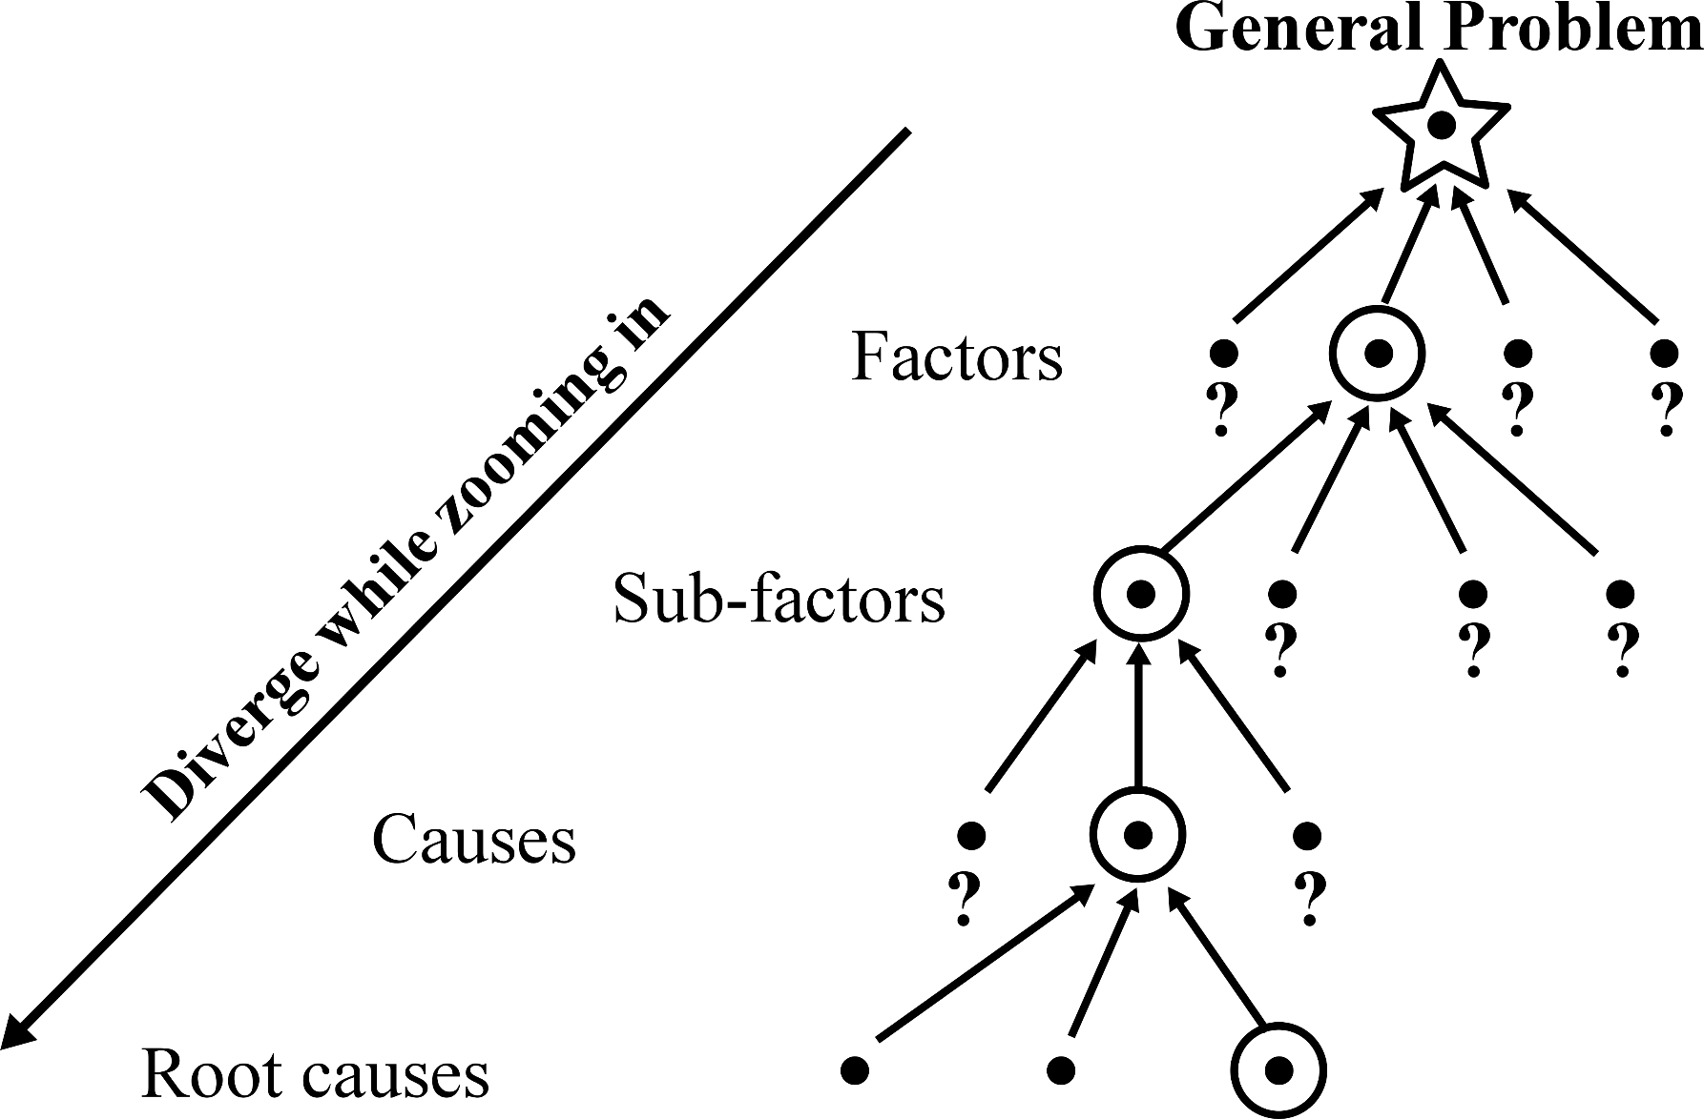
Level 1 Archeological Dig
At each level of the “dig” we are:
Diverging “potential causes” that could cause the problem
Organizing these factors
Selecting ONE factor, then REPEATING the process
Is this a problem you can do anything about?
Within our circle of influence?
Align with your Capabilities?
Creates a Series of DOC Process applications

Slide 10
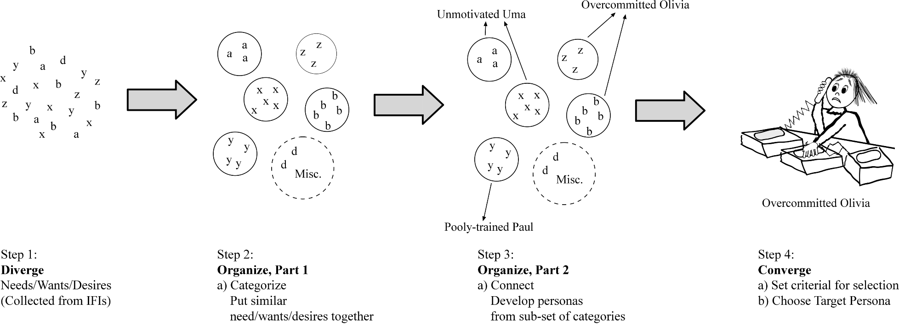
Persona Creation
Figure A.2 from the text
More Details on this in Session 07

Slide 11
DOC Process applied to Solution Formulation
More details on this in Session 07 – Solution Formulation

Slide 12
Solution Formulation Divergent Thinking
Divergent Thinking
(one idea)
(Many, Many Ideas)
Begin with a well-defined need/want/desire with a well-defined Target Adopter persona
What is their current BATNO (Best Alternative to a New Offering)?
Why does this NOT work for them?
What can we do to better address their primary or secondary unmet or under-met needs/wants/desires
Make sure you consider all levels of the problem (See next slide)

Slide 13
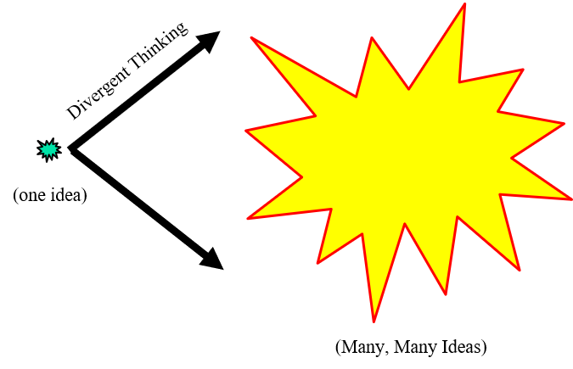
Solution Formulation Divergent Thinking: Brainstorm at different levels
Streamline
connections
System-level
Solution Formulation
Zooming In/Out
Substitute
Product
Function-level
Current Solution
Feature-level
What is been tried in the past?
What is the best current solution?
BATNO (Best Alternative To a New Option or Offering)
What is the perceived short-comings to the BATNO?
Brainstorming here will give product variations of the same solution; i.e. “me too” products (see next slide)

Slide 14
Generic Solution Approaches
Feature Level: “Me Too” Products--essentially a product/service to those that exist, but with some advantage, such as:
New Features. Increased convenience (ex. new delivery mechanism to user, Netflix vs. Blockbuster)
Inherent cost advantages over incumbents, such as:
Lower capital requirements
Lower raw material costs
Economy of scale (ex. Using the internet to get economy of scale for services)
Function Level: Substitute product (different solution for same need)
Better, faster, cheaper, more convenient than existing product/service
(ex: MP3 players vs. CD players)
Better addresses an emerging or previously unidentified or underserved market segment than existing offerings (ex: cell phones vs. land-lines)
Change forms: “Product as a service” or “Service as a product” (Pandora vs iTunes)
System Level: Streamline connections – creating efficiencies between existing business segments
Ebay bringing buyers and sellers together, reducing the cost of customer acquisition for sellers, and increasing convenience for buyers
Most apps are this: Uber and Lyft apps makes it easier for a taxi seeker to find taxi service
Analogies to other problem/solution pairs?
Eg: Mainframe to PC to Network → Central Power Creation to “off grid” to micro-grids
14

Slide 15
Organize and Converge
Brainstormed ideas are created with “differed judgement” (without thinking)
Too many groups then just “pick” one of these ideas without applying ANY critical thought – huge mistake!
Organize step is opportunity to
Classify ideas taking similar approaches
See if there is an approach that is missing
Combine related ideas from divergent thinking
Convergence (selection) requires Criteria!

Slide 16
Examples
See text for examples
Chapter 3 – Problem Identification
Chapter 4 – Solution Formulation
Chapter 8 – DOC Process Overview
Chapter 9 – Diverge step
Chapter 10 – Organize step
Chapter 11 – Converge step
Appendix A – Interviewing for Insight
& Persona Development

Slide 17
Common Mistakes
Skip the ORGANIZE step
This is where the ANALYSIS takes place
Divergent is usually a “no thinking” step
Why would you randomly choose an idea created without thinking?
No analysis to see what could be missing
Organizing the information allows you to step back and see the bigger picture
This broader purview allows you to see what is missing – a critical attribute to a creative problem-solver
No public/shared criteria for selection
Each participant has their own (private) criteria
Random criterial leads to random choices

Slide 18
Questions?
Zoom session on this Session.
See syllabus for time/date.

