Slide 1
CLIC 804
Fall 2022
Session 05:
The Innovation Pyramid
Level 1 – Problem Identification
Dr. Tim Faley
Kiril Sokoloff Distinguished Professor of Entrepreneurship
Special Assistant to the President for Entrepreneurial Initiatives
University of the Virgin Islands
Fall 2022

Slide 2
Layout of The Innovation Pyramid
The Situation
Level 1
Design, Stage 1:
Problem Identification
Design, Stage 2:
Solution Formulation
Level 2
General Movement
Execution, Stage 1
Plan Development
Level 3
Execution, Stage 2
Implementation
Level 4
Resolution

Slide 3
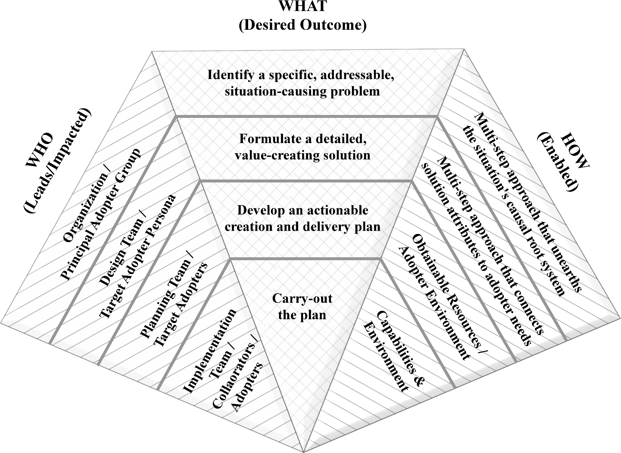
Level 1: Design Stage 1 (Problem Identification)

Slide 4
Starting Point for Level 1, Design Stage 1
Many options
Innovator situation
Adopter situation
Existing adopter solution
Proposed adopter solution
Want to first Zoom out
Want to make sure we are not missing anything
Zoom-out to “mission-level” Perspective (of the creator of the innovation)
Broad view, but still within the scope of the organization

Slide 5
Level 1 Method Overview
Problem Identification Five-step guideline:
Step 1: Clearly state the starting situation or issue
Step 2: Zoom out to define the General Problem
Step 3: Draft a neutral problem statement
Step 4: Zoom in, layer-by-layer, to a root cause
Step 5: Identify the Principal Adopter

Slide 6
Hypothesis-directed Discovery

Slide 7
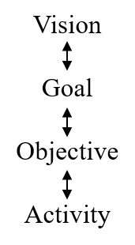
Steps 1 & 2 of 5
Step 1: Clearly state the Initial situation
Step 2: Zoom out to define the General Problem
We want to make sure we are looking at the problem from a broad enough perspective to ensure that no potential solution is overlooked
Zoomed out “far enough” if at an organization’s “mission/vision” level (ideally)
At least the “Goal” level

Slide 8
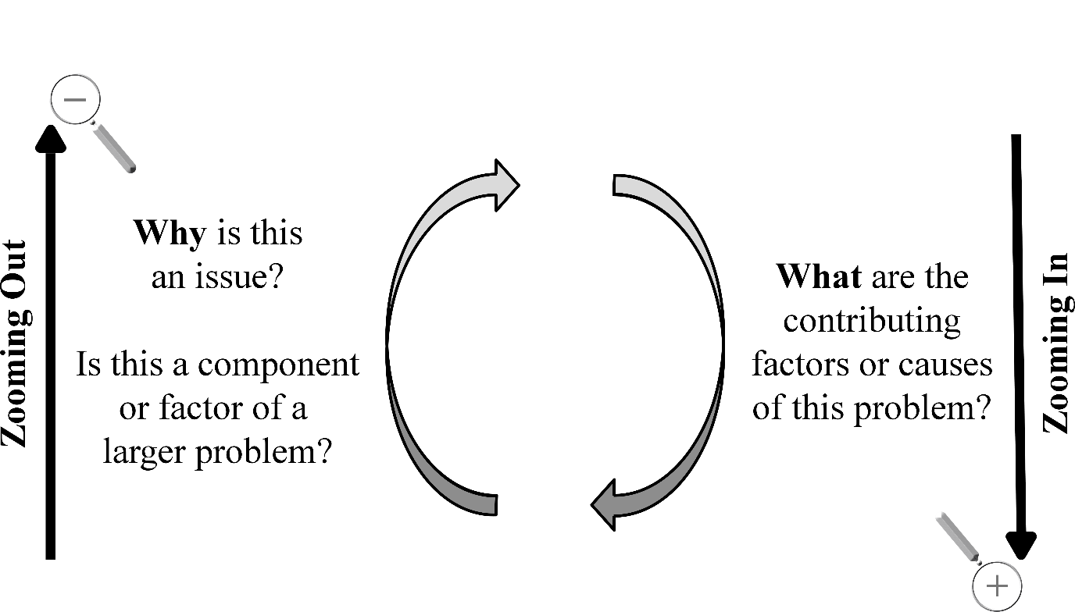
Zooming In/Out Problem Space

Slide 9
Cause versus Effect
Cause: Factor or component that contributes to the problem’s existence
When we zoom in on the problem, we are looking for causes, not effects of having the problem
Effect: a consequence or result of having the problem
Example:
Problem: My garden is not producing as many vegetables as I need
Causes: birds eating the budding fruit, garden is small, etc.
Effects: I’m not getting a balanced diet, I have to buy vegetables at the store (which cuts into money I have to other things)

Slide 10
Zooming in/out of Problem Space
Zooming in:
Looking for CAUSES of the stated
Zooming out:
Looking for BIGGER issues to make sure we are not too focused on a small (and maybe wrong) issue.
Example: Let’s say we said the issue is “Birds are eating all my budding vegetables.” Why is this a problem? Why do I care?
My garden is not producing the vegetables that I desire.
So why is this a problem?
I need vegetables for a balanced diet
Without my garden have to go to the grocery to buy vegetables.
Why is this a problem? If I buy all the vegetables I need, then I don’t have enough to pay my rent.
The “Bigger issue” is food availability. I don’t have enough resources to purchase all the food I need to sustain myself. A garden is one, but only one way, to resolve this issue.

Slide 11
Step 3 of 5
Step 3: Draft a neutral problem statement
A problem statement is a “neutral” statement of the facts. More difficult to create a “pure” problem statement that one would think (because we humans think in terms of “actions,” “solutions”).

Slide 12
Problem Statement
Neutral statement of facts
Is non-judgmental
Often “balances”
Example: There is no “energy shortage” …instead, “the demand for energy exceeds its supply”
Any action verb suggests a solution…
“How to…” or “How might we…”
“What are all the ways…”
“We need to increase… “ or “The ___ is too low”
Are all “actions” or inferred actions and therefore lead us to proposed “solutions”

Slide 13
From the example
How can I restate the “food” issue?
How about: “My food and rent costs exceed my income.”
It is factual
It is non judgmental
It does not imply a “solution” (as “I need more food” or “I need more income”)
Note how this problem re-statement opens up more possibilities for both potential root-cause issues and potential solutions (well beyond ‘bird control’)

Slide 14
Step 4 of 5
Step 4: Zoom in, layer-by-layer, to a root cause
Once we have broadened our perspective, we need to drill it back in to something the organization can do something about
What are the factors that contribute to the issue? The causes?
NOT the effects (of this problem)?
Ex. My house water pump does not work. What could be the causes? The fact that I could die of dehydration if this is not fixed will not help me fix the pump!
This step takes RESEARCH – both primary and secondary (google searches). Start with secondary research and move to primary research as needed.
Research is a DIVERGENT activity
Will need to ORGANIZE the results of the research
See Chapter 10 of the Text and next slide

Slide 15
Archeological Dig: Diverge as Zoom in
Understanding the links (from top to bottom) is key to knowing that solving the “root cause” will impact the initial “situation”!

Slide 16
Step 4 of 5
Step 4: Zoom in, layer-by-layer, to a root cause
Once we have broadened out perspective, we need to drill it back in to something the organization can do something about
What are the factors that contribute to the issue? The causes?
NOT the effects (of this problem)?
Ex. My house water pump does not work. What could be the causes? The fact that I could die of dehydration if this is not fixed will not help me fix the pump!
This step takes RESEARCH – both primary and secondary (ex. Google searches). Start with secondary research and move to primary research as needed.
Research is a DIVERGENT activity
Will need to ORGANIZE the results of the research
See Chapter 10 of the text, on the next slide and in Session 06

Slide 17
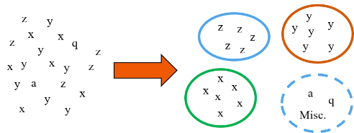
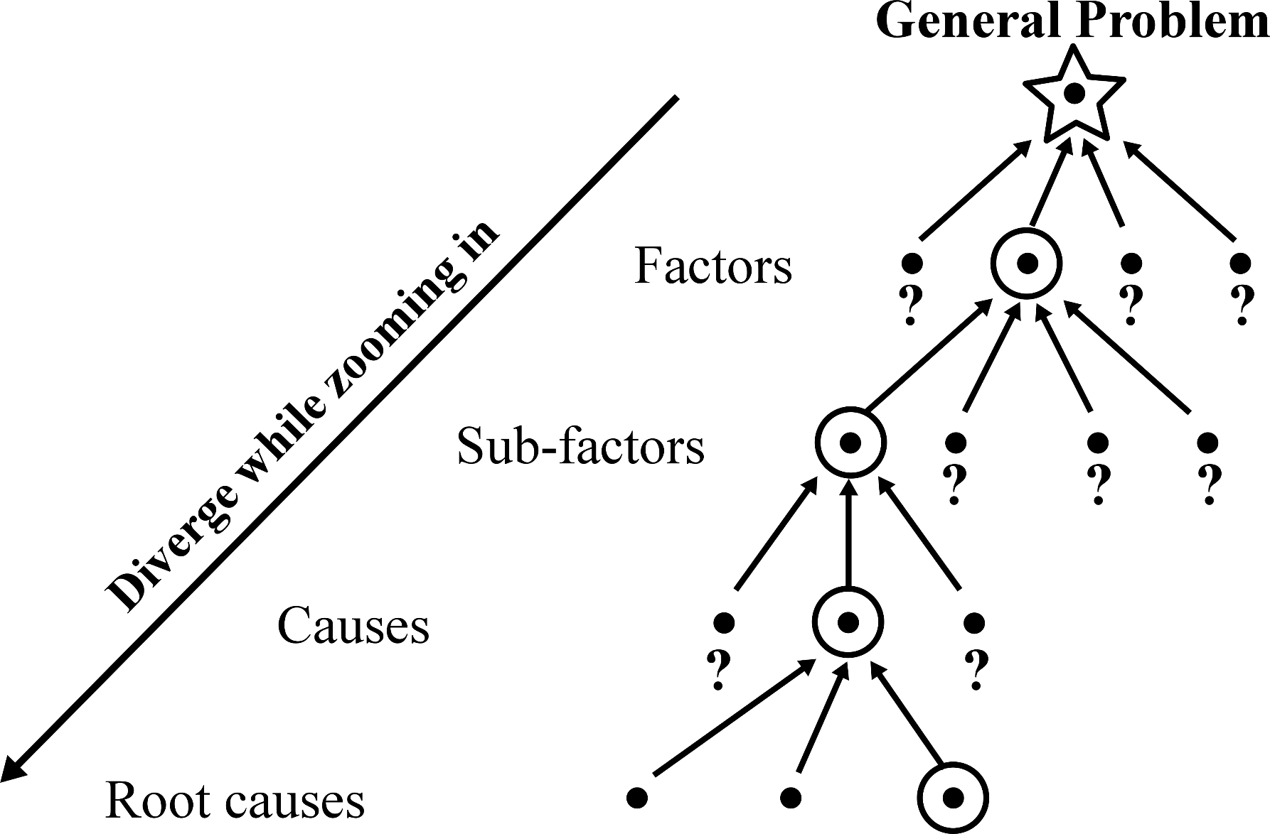
Level 1, Organizational Thinking (PI)
Categorize
Classify/Group information
Name Categories
Connect
Are there connections or sequences that occur within or between categories?
Is there a sequence? Does one follow another?
Cause
Does category “cause” another to occur?
PI = Problem Identification

Slide 18
Step 5 of 5
Step 5: Identify the Principal Adopter
Clearly identified problem must have a clear group that is “suffering” from this problem
“Who” is directly affected by the identified problem
No clear “who” then need to keep digging
Generally speaking, this group will be the adopters of the innovation created to address the identified problem
The “Principal Adopter” group is still too broad, however, to craft a specific solution for
This “Principal Adopter” will be narrowed to a specific “Target Adopter” in Level 2 of The Innovation Pyramid

Slide 19
Outcome of Design Stage 1 (Problem Identification)
Defined a General Problem from our initial situation.
Determined a root cause of that General Problem for which our organization is able and willing to resolve.
Determined the connections between the root cause and the General Problem.
Identified an adopter group that is both impacted by the root cause issue and will be the general group for whom we are creating the innovation.
Refer to example in Chapter 3 of the Textbook.

Slide 20
Level 1: Design Stage 1 (Problem Identification)

Slide 21
Common Mistakes of Level 1
Skipping this Level Entirely (stay in “solution space”)
Jump straight to a “solution” (Level 3)
Start with a solution (“we need to stop kids from cutting class”) and then define the problem as a reflection of the solution (“too many kids cut class”)
Keep the scope of the problem too big (need to find a root cause of “world peace” that we can do something about!)
Logic leaps and phantom links
Never connect the “root cause” to the real issue
Or find or conjure up “data” to support the conclusion we’ve already made

Slide 22
Questions?
Zoom session on this Session.
See syllabus for time/date.

