Slide 1
CLIC 804
Fall 2022
Session 01: This Course’s
Approach to Innovation
Dr. Tim Faley
Kiril Sokoloff Distinguished Professor of Entrepreneurship
Special Assistant to the President for Entrepreneurial Initiatives
University of the Virgin Islands
Fall 2022

Slide 2
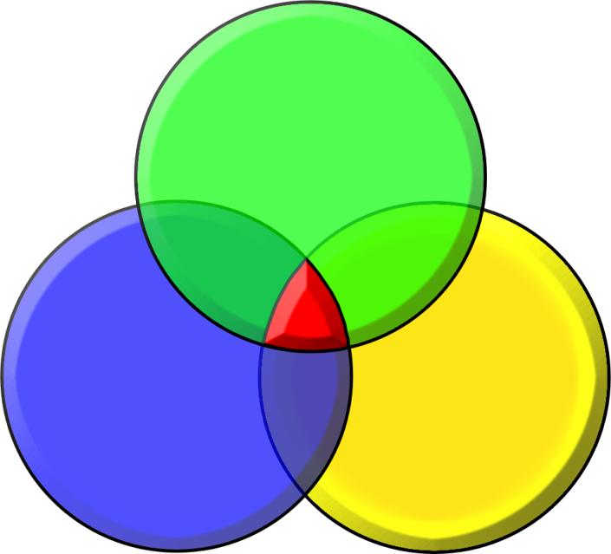
Innovating Requires 3 Major Parts
Getting things done
through organizations:
CREATIVE
LEADERSHIP
PEOPLE
METHODOLGY
ENVIRONMENT
In other words: 3Ps == People, Process, and Place
Notes:
“Process” implies “recipe” which is not the case; method is a way to approach

Slide 3
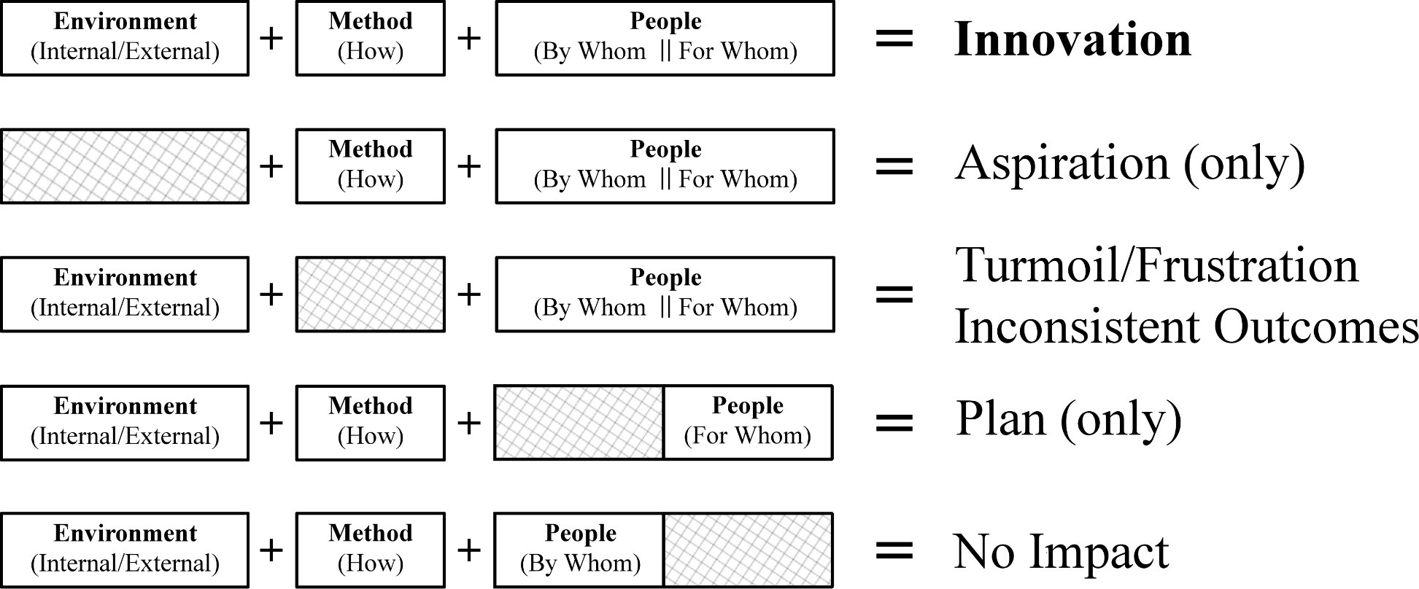
Need all three components

Slide 4
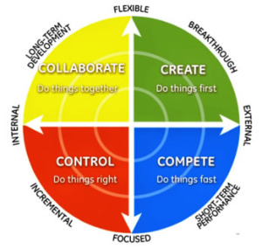
People
Notes:
Danger of “Group Think”
Dr. Puccio presented Foursight model

Slide 5
Environment
For a generation raised on-line…
There is a need for Stimulating Random Creative Collisions
Complex problem-solving is a TEAM Sport
(African Proverb: If you want to go fast, go alone.
If you want to go far, go together)
Notes:
Need dynamic interactions for creative thinking

Slide 6
This course focuses on METHODOLOGY
Helping people be individually more creative is NOT a methodology
Putting a a diverse set of creative people (Clarifier, Implementer, etc.) in a room is NOT a methodology
A method is a detailed approach – a way of doing something
An approach (or instruction set) needs tools, techniques and skills to be actualized

Slide 7
The Innovation Pyramid methodology
Methodology is NOT a recipe
No guaranteed outcome
Methodology is learnable
Methodology is repeatable
The Innovation Pyramid methodology is Non-linear and iterative
Does not necessarily go from A→B→C…
Can go many directions A→C or A→B, etc. and can go backwards
Knowledge-based
Learning method…. Decisions based on information gathered

Slide 8
Building a house (a metaphor)
Getting the right sequence of activities is important
You cannot put the roof on before the walls go up!
Typical Order:
Prepare construction site and pour foundation
Complete the rough framing of the dwelling
Install the roof
Complete the rough plumbing, electrical and HVAC
Etc.

Slide 9
Zoom in to see the details
Each major “stage” (or “layer”) of the dwelling’s development has detailed steps that must be completed
These details are revealed upon closer inspection of each stage of the method
Zoom in to reveal details (see next slide)

Slide 10
Changing Perspective: Zooming In and Out
The Forest
Zooming Out and Zooming In
The Tree
“Nested” – One “inside” the other
The Leaf

Slide 11
Each stage requires tools/techniques
Over-arching Method
Sub-
Components
Activities
A B C D
Processes/Tools/Techniques for accomplishing Activities
Each “stage” has a number of steps that must be accomplished
Each “step” requires tools/techniques to perform
Some tools/techniques are applicable to many steps within different stages of the process
Examples: sawing lumber, hammering nails, etc.

Slide 12
Tools are not a method
While tools/techniques are important for IMPLEMENTATION of a methodology, they do not replace a methodology
Just because you know how to cut wood and hammer a nail, does not mean you know how to build a house. You are missing the overall INSTRUCTION set that gets you there.
The converse is also true. If you have a detailed instruction set, but have none of the tools/techniques to implement it, you will not be successful.

Slide 13
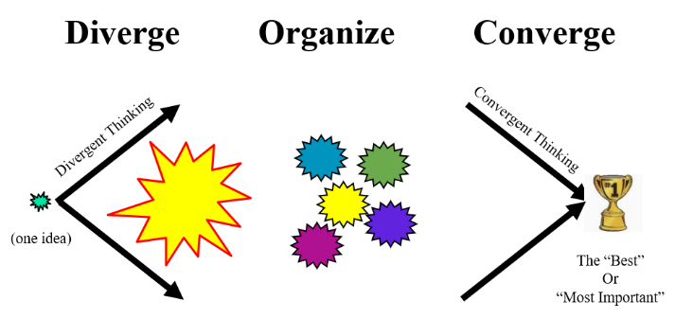
Changing Perspective: Zooming In and Out
The
Innovation
Pyramid
methodology
“The Forest”
“The Tree”
Zooming In/Out
The
DOC
Process
“The Leaf”
Brainstorming
Tools
& Techniques
Interviewing for Insight
Pareto Analysis
Story Boarding
Persona Development
Know / Wonder

Slide 14
The Innovation Pyramid
The Innovation Pyramid is the overall methodology
The DOC Process is a major sub-process in its implementation (like “masonry know-how” is an important sub-process of home-building in the Territory)
Specific tools/techniques are required to implement the DOC Process and other components of The Innovation Pyramid

Slide 15
But first….
… before we talk about HOW to create an innovation
Let’s discuss what an “innovation” is (and is NOT)
(Session 02)

Slide 16
Questions?
Next Zoom session -- See syllabus for details.
E-mail me any questions/concerns you may have.
Make sure you put “CLIC 804” in the subject line of the e-mail!

