Slide 1
CLIC 804
Fall 2022
Innovation By Design
Session 00: Course Structure and Scope
Dr. Tim Faley
Kiril Sokoloff Distinguished Professor of Entrepreneurship
Special Assistant to the President for Entrepreneurial Initiatives
University of the Virgin Islands
Fall 2022

Slide 2
About me..
Consultant, author, financier, scientist, entrepreneur, researcher, and educator
Published in Journals, Magazines, Newspapers, Books
Focused on accelerating the creation and development of new products, processes, businesses and economies.
Half my career in industry, half in academia
Research, new business development, technology licensing, and corporate venture capital; associated with over 30 ventures
15-years at Univ. Michigan
Created #1 Graduate Program in Entrepreneurship in the Nation (Princeton Review, 2013)
AY21-22 will be my 9th year at UVI
Published by Cambridge University Press, 2015
Published by Cambridge University Press, Jan. 2021

Slide 3
Office Hours
tfaley@uvi.edu
Set up a time to meet by phone, or zoom
I check e-mail OFTEN
340-693-1310 (office) (Will NOT be there!)
734-223-8296 (mobile) (use with discretion)
Try this FIRST

Slide 4
Course Materials
Textbook:
The Innovation Pyramid, available a many on-line sites (see www.TheInnovationPyramid.com for details)
Auxiliary Reading Material
Articles, Book chapters, Blogs, Cases
Available on Blackboard
Electronic Tools
Zoom (zoom.us)
On-line meeting tool/space
Mural (Mural.co)
electronic, sharable, collaborative whiteboard

Slide 5
Course Philosophy
“We can't solve problems by using the same kind of thinking we used when we created them.” – Albert Einstein
Today we need new perspectives, new tools, and new techniques to solve the new problems we are facing today.

Slide 6
Grading Structure
Grading structure:
Cases & Assignments 30%
Meaningful Zoom Discussion: 10%
Midterm: 30%
Final 30%
Everything due before Midnight (Atlantic Standard Time, AST)
All assignment due dates in syllabus
25% off every 6 hours that it is late
Date & Time: Max Score:
Before Midnight on due date 100%
Before 6am on day after due date 75%
Before Noon on day after due date 50%
Before 6pm on day after due date 25%

Slide 7
Course Evaluation (1 of 2)
Case Studies & Assignments
Test understanding of materials and the application of the tools
At least 2 written assignments (two parts each) throughout the semester
“Experiential” learning assignments
Discussion
Meaningful participation in zoom discussions
8 scheduled zoom sessions (several are optional)
Will be able to be excused from ONE zoom discussion over the semester
Midterm and Final –
Papers or Case analyses
Due dates on Syllabus

Slide 8
Course Evaluation (2 of 2)
There is lots information out there
Some good, some not-so-good
In addition, different courses in this program will introduce similar material in slightly different ways – this is a GOOD thing. BUT…
Your papers will be HEAVILY weighted on the USE of the COURSE materials and the approach to Impactful Problem-solving that this course lays out
Your grade is determined by how well you demonstrate that you have learned and can apply the material of this course
I cannot assess whether or not you can apply the information of this course if you don’t use it in the development of your paper

Slide 9
Course presents a learnable, repeatable methodology for becoming a Serial Innovator
(as an individual or an organization)

Slide 10
Core Course Content
Introduction to Innovation
The Innovation Pyramid methodology
Design thinking-based Overall “guideline” or “roadmap” for developing and delivering innovations
Two Design layers, Two Execution Layers
Processes, tools and techniques for implementing The Innovation Pyramid
The DOC Process
Creativity-based process for reducing The Innovation Pyramid to Practice
Works on both the “Problem Space” and the “Solution Space”
Tools/Techniques
Approaches for implementing the DOC Process

Slide 11
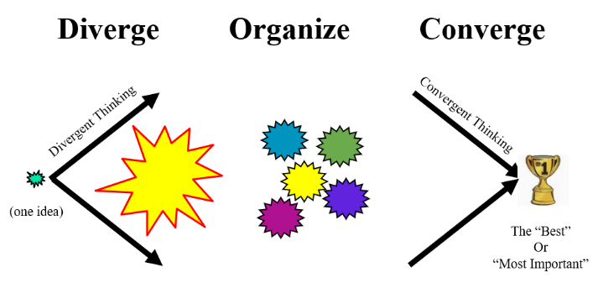
Changing Perspective: Zooming In and Out
The
Innovation
Pyramid
methodology
“The Forest”
“The Tree”
Zooming In/Out
The
DOC
Process
“The Leaf”
Brainstorming
Tools
& Techniques
Interviewing for Insight
Pareto Analysis
Story Boarding
Persona Development
Know / Wonder

Slide 12
Layout of The Innovation Pyramid
The Situation
Level 1
Design, Stage I:
Problem Identification
Design, Stage II:
Solution Formulation
Level 2
General Movement
Execution, Stage I
Plan Development
Level 3
Execution, Stage II
Implementation
Level 4
Resolution

Slide 13
Lollipop Effect
If your innovation does not address the REAL problem, then your so-called solution is nothing more than a lollipop

Slide 14
Context and Questions
Session 01 will get more into the approach to innovating that we’ll be taking in this course.
Make sure you e-mail me (Tfaley@uvi.edu) any questions you might have. Please put “CLIC 804” in the e-mail subject line to make sure it does not get lost in my very full in-box.

